Slide 1


ANALYZING AMAZON SALES DATA
Internship Project By Pooja Upadhye with UNIFIED MENTOR

Slide 2

CHALLANGE OVERVIEW
Sales management has gained importance to meet increasing competition and the need for improved methods of distribution to reduce cost and to increase profits. Sales management today is the most important function in a commercial and business enterprise.

Slide 3
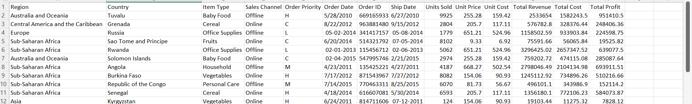
OVERVIEW OF DATASET

Slide 4

MAIN KPI’S
(Key Performance Indicators)
Total Revenue
Total Cost
Total Units
Unit sales

Slide 5

UNVEILING THE INSIGHTS
Sales Trends: Identified patterns in sales performance across months, years, and yearly-month combinations.
Metric Matchmaker: Discovered key metrics and factors that influence sales, revealing hidden relationships within the data.

Slide 6
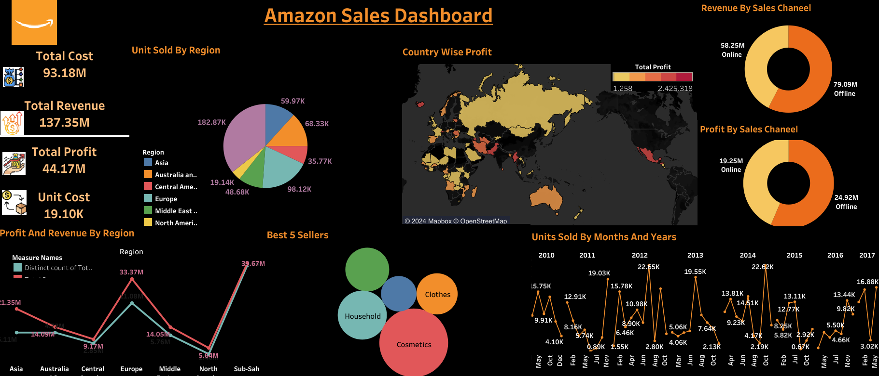
DASHBOARD OVERVIEW

Slide 7

WHAT I LEARN
The importance of data cleaning for reliable analysis with SQL.
The effectiveness of Tableau for crafting impactful data stories.
A huge thank you to Unified Mentor Private Limited for providing this incredible learning opportunity!

Slide 8
THANK YOU

